Slide 1
Plant Disease Detection

Slide 2
Table of Contents
01.
02.
03.
04.
05.
06.
Problem Statement
Problem Description
Solution and its working
07.
Technologies used
Example
Prototype
And future developments
Real life problem
and its effectiveness

Slide 3
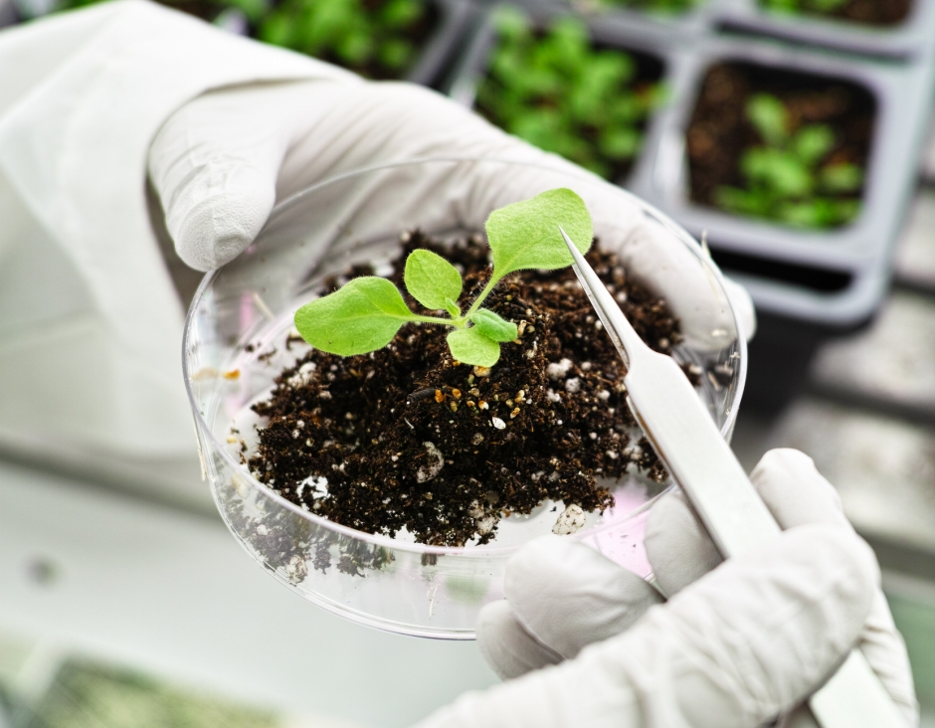
Problem Statement
Unnecessary excessive use of Pesticides on uninfected plants results in health issues which includes problems like cancer, kidney and liver damage, sometimes death and environmental issues like infertile soil, killing of useful bacteria and insects, contamination of fresh ground water.

Slide 4
Problem Description
Nowadays pesticides usage is more without even
knowing the infected part of a plant. The farmers are
using more pesticides to the plants in the field without
any concern of how it is affecting the disinfected
plants and human health. Our focus is to clarify the details
about the diseases and how to detect them promptly
with Deep learning.

Slide 5
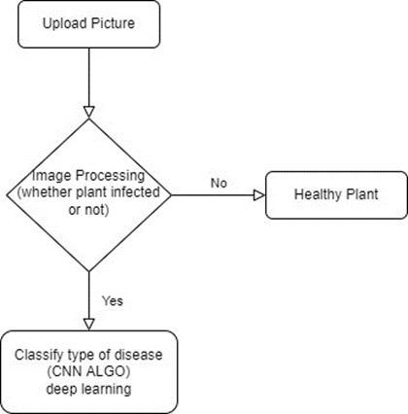
Flow Chart

Slide 6
Solution
We are using Image Processing to discover the type of disease. Which is implemented to find solutions for both the problems related to classification and regression.
During the terminal stage, users are recommended with the treatment. Mostly live plants are adversely affected by the diseases.
This project imparts representation of leaf disease detection employing Image Processing that can identify drawbacks in plants from images, based on colour, bound and texture to give the brisk and reliable results to the farmer.

Slide 7
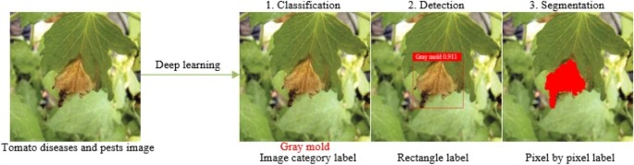
How our solution is working
We use a website page , where we can able to upload the image and it act as a
Graphical User Interface by using HTML, CSS, JAVASCRIPT.
We use Image Processing in python language to implement this website
as this uses the uploaded image of the leaf or plant to detect what type of the disease.
We use datasets which are of Deep learning where we train and test the data to implement successfully.

Slide 8
Our solution can help these real life problems
In 2017, 63 farmers and farm laborer's died from the fatal effects of
mishandling of toxic pesticides in Maharashtra, most from eastern and
northeastern parts; of them, at least 21 deaths were from Yavatmal
district in the Vidarbha region. Many more such cases of mishandling
and over usage of pesticides are reported in our country.

Slide 9

Solution Effectiveness
Time efficient
Less wastage and more production
of healthy plants
Save the soil fertility
Saving further water pollution
Reduce the extra toxicity of pesticides
Reduce the cost of the pesticide

Slide 10
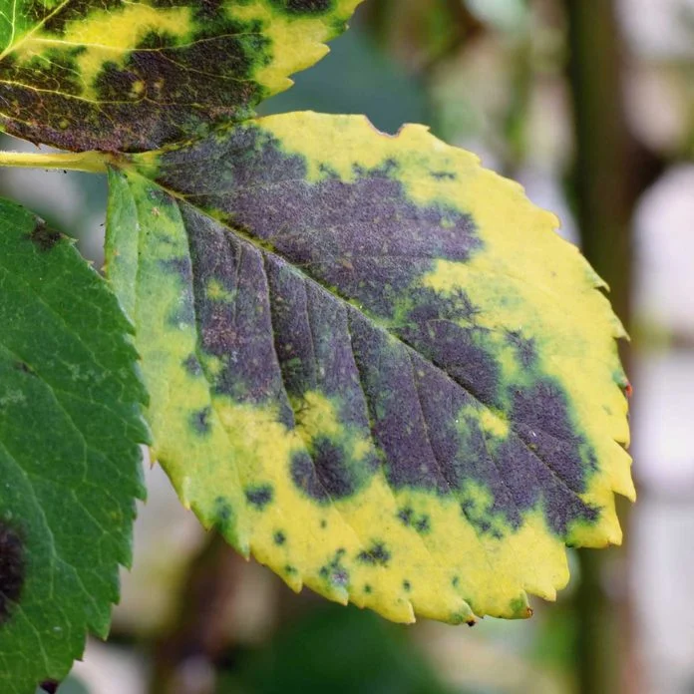
Technologies used
Deep Learning
CNN (Convolution Neural Network)
Image Processing
Data sets
HTML
CSS
Javascript
Python

Slide 11
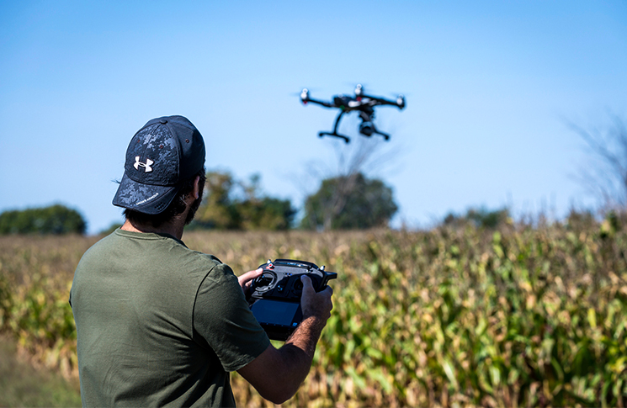
Example (Already Developed)
Drones working to detect crop
disease early, propel agricultural
research forward.
By- Addison Dehaven
(south Dakota State University)

Slide 12
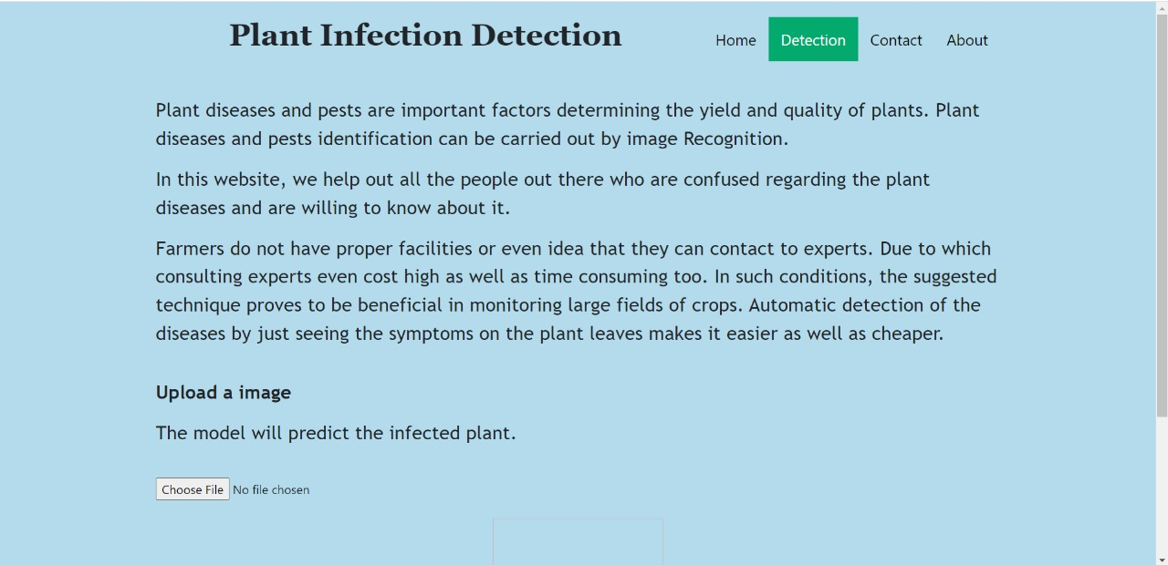
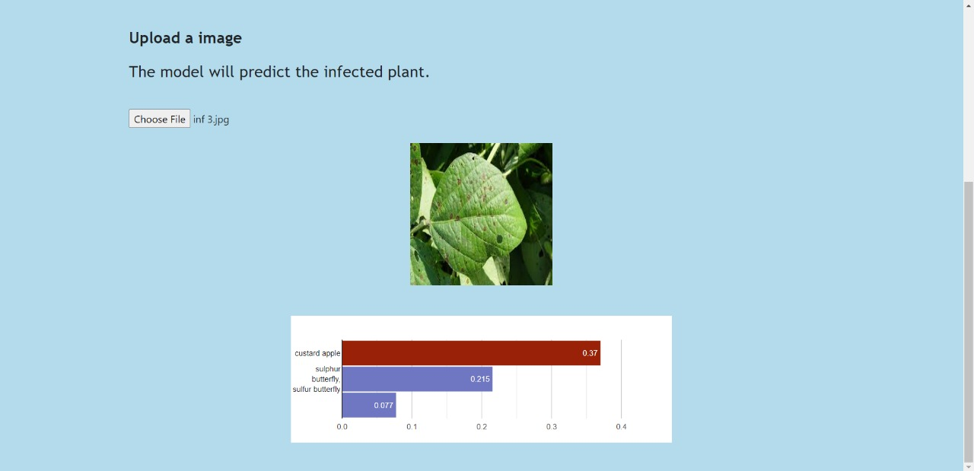
Prototype (Our Solution)

Slide 13
Future (Additional Implementation)
To improve the efficiency and accuracy of the screening and analysis of
farm we will collaborate with Robotics and build rovers to inspect the
plants in the farm directly and target by using Mathematical COORDINATES
or GPS to locate the infected crops and take picture of it also it will find
what is the disease and it gives treatment to the crop. This will help
farmers to take care of the field and the crops 24/7 and save time.

Slide 14
Thank You
Made By:-
K.Santhanalakshmi
Dikcha Singh
Kondreddy Bhagya Sree
Jeba Sonia Anand (MENTOR)

